Slide 1
Community Based Reporting and Monitoring Tool for Women Safety in Colleges/Universities
CSE7301 University Project-II
Final Review
Batch Number: CSE-G42
20211CSE0262 | MARRIBOYINA MOUNIKA
20211CSE0305 | CHALLA OMNATH
20211CSE0274 | CHAITRA K
Under the Supervision of,
Dr. Afroj Alam
Professor / Associate Professor / Assistant Professor
School of Computer Science & Engineering
Presidency University
Roll Number | Student Name

Slide 2
Introduction
The Mobile Application for Women Safety is an Android application designed to provide a sense of security and support for women in vulnerable situations. Users can register and login with their details, enabling access to features tailored for their safety. With the ability to view nearby users and send SOS alerts with audio and video capabilities, individuals can swiftly seek assistance in emergencies. Additionally, users can receive SOS alerts from nearby individuals and provide aid when needed. This intuitive application leverages technology to foster a supportive community and enhance the safety and well-being of women. By facilitating quick and efficient communication in critical situations, the Mobile Application for Women Safety aims to empower women and promote a safer environment for all.

Slide 3
Problem Statement
The problem lies in the lack of an effective and accessible safety solution for women. Current systems often fail to provide timely assistance in emergency situations, leaving women vulnerable to various threats. There's a need for a mobile application that enables women to easily connect with nearby users, send SOS alerts with audio and video capabilities, and receive assistance promptly, ensuring their safety and well-being.

Slide 4
Literature Review
AUTHOR | YEAR | TITLE | OUTCOMES
Kaur, A., & Singh, G. (2018) | 2018 | Mobile App Development for Personal Safety.​ | SOS and location sharing improve emergency response times and campus safety.
Bansal, A. & Tiwari, M. | 2017 | Use of AI in Emergency Response Systems. | AI offers real-time guidance during emergencies; supports chatbot use in safety apps.
Smith, M. & Jones, L. | 2019 | Review of Safety Apps and Their Limitations. | Many apps lack full safety features; supports a comprehensive solution with campus integration.
Patel, R. & Desai, K. | 2020 | Importance of Real-Time Communication in Safety Apps. | Real-time alerts help notify security and loved ones quickly, reducing harm.
Zhang, L. & Wang, X. ​ | 2021 | Use of Audio and Video in Mobile Apps for Emergency Evidence. | Recording helps verify situations and supports quicker authority response.

Slide 5
Literature Review
Kumar, S. & Singh, P. | 2019 | Role of User-Friendly Design in Emergency Apps. | Easy-to-use interfaces improve app use during emergencies.
Reddy, M. & Choudhury, A. | 2020 | Deep Q-learning for Same-Day Delivery with Vehicles and Drones. | AI logic can help in route and complaint optimization, useful for chatbot intelligence.
Patel, J. & Kumar, N. | 2023 | Community-Based Reporting to Improve Campus Safety. | Sharing reports via apps builds a more supportive and aware community.
Gupta, A. & Sharma, R. | 2018 | Role of Location Sharing in Emergency Response. | Real-time location sharing helps reduce emergency response time.
Shah, N. & Kapoor, V. | 2022 | Integration of AI Chatbots in Emergency Services. | AI chatbots can guide users, answer questions, and help report incidents instantly.

Slide 6
Findings For Literature Survey
S.NO​ | YEAR​ | AUTHORS​ | IMPLEMENTATION​ | WHAT PROBLEM THEY FACED​
1​ | 2018 | Kaur, A. & Singh, G.​ | Implementation of SOS alerts and live location sharing in safety apps.​ | Lack of effective real-time communication during emergencies.​
2​ | 2017​ | Bansal, A. & Tiwari, M. | Integration of AI chatbots in emergency apps to guide users and offer advice in real time.​ | Slow response times due to lack of automated assistance.
3​ | 2019 | Smith, M. & Jones, L. | Development of a comprehensive app integrating SOS alerts, location sharing, and security communication. | Many apps lack integration with campus security systems.​
4​ | 2010 | Patel, R. & Desai, K. | Implementation of real-time alert systems to security teams and loved ones for quicker responses. | Delays in communication during emergencies.
5​ | 2021 | Zhang, L. & Wang, X. | Incorporation of audio and video recording features in safety apps to capture evidence during emergencies. | Lack of evidence collection in emergency situations.

Slide 7
Findings For Literature Survey
6​ | 2019 | Kumar, S. & Singh, P. | Focus on designing easy-to-use apps for better usability, especially in stressful situations.​ | Complex interfaces reducing user engagement.​
7​ | 2020 | Reddy, M. & Choudhury, A. | Use of reinforcement learning and AI to optimize dynamic response and routing logic in safety app responses. | Inefficient routing of delivery systems.​
8​ | 2023​ | Patel, J. & Kumar, N.​ | Development of features in safety apps encouraging students to report safety issues and collaborate in real time.​ | Lack of community involvement in addressing safety concerns.
9​ | 2019 | Gupta, A. & Sharma, R. | Integration of real-time location sharing to speed up emergency response time. | Delay in locating individuals during emergencies.
10​ | 2022 | Shah, N. & Kapoor, V. | AI chatbot integration in safety apps to provide instant guidance, report incidents. | Lack of immediate assistance in emergencies.

Slide 8
Proposed Method
The proposed Mobile Application for Women Safety is an Android platform solution designed to provide women with a reliable safety tool. Users will register and log in securely, accessing features tailored for their protection. The application will allow users to view nearby individuals and send SOS alerts with audio and video capabilities in emergency situations. Additionally, users can receive SOS alerts from nearby individuals and offer assistance as needed. With a user-friendly interface and robust functionality, the proposed system aims to empower women to seek help swiftly, fostering a safer environment and promoting their well-being.

Slide 9
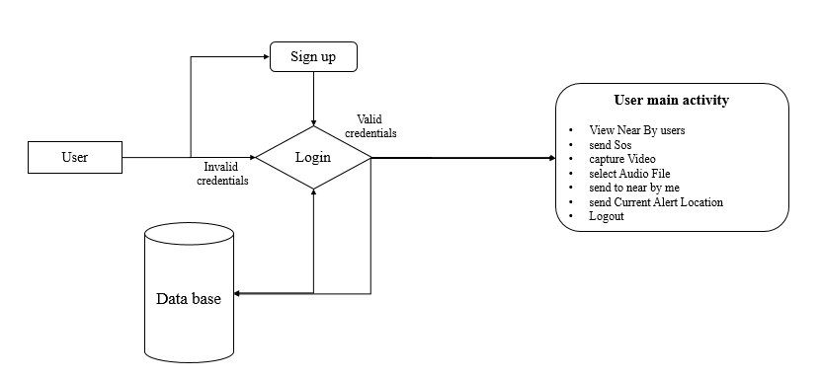
Project flow

Slide 10
Objectives
The objective of this project is to develop a comprehensive Mobile Application for Women Safety on the Android platform. The application aims to empower women by providing them with a reliable and accessible tool to enhance their safety and well-being. Key objectives include enabling users to register and login securely, view nearby users, and send SOS alerts with audio and video capabilities in emergency situations.

Slide 11
Methodology
Hardware Requirements
Processor - I3/Intel Processor
RAM - 8 GB
Hard Disk - 1TB
Software Requirements
Operating System - Windows 10
JDK - java
Plugin -Kotlin
SDK - Android
IDE -Android studio
Database` - server script, my sql

Slide 12
Timeline of Project
Project Duration:
4 months (16 weeks)
Phases:
Literature, Identification Modules, Implementation Modules, Testing of Modules, Publishing Preparation of Papers, and Maintenance.
Key Milestones:
Week 1-2: Literature
Week 3-5: Identification Modules
Week 5-9: Implementation Modules
Week 9-12: Testing of Modules
Week 12-13: Publishing Preparation of Papers
Week 14-16: Maintenance

Slide 13
Expected Outcomes
1. Increased Reporting: Encourages anonymous and real-time reporting of harassment or safety concerns by female students.
2. Improved Campus Safety: Enables authorities to identify unsafe zones and take preventive actions based on crowd-sourced data.
3. Community Engagement: Builds a support network where students can share alerts and experiences, fostering collective vigilance.
4. Data-Driven Decision Making: Generates insights and reports for administration to implement targeted safety measures.
5. Empowerment of Women: Enhances the sense of security and confidence among female students on campus.
6. Accountability and Transparency: Promotes accountability of college authorities in responding to and addressing reported incidents.

Slide 14
GitHub Link
https://github.com/GuruPrasadAnanthaneni/Postal_AI_App

Slide 15
Conclusion
In conclusion, the Mobile Application for Women Safety stands as a beacon of empowerment and support, leveraging technology to foster a safer environment for women. With its intuitive features allowing for swift communication and assistance, it enables users to navigate vulnerable situations with confidence. By promoting community-driven aid and facilitating rapid response mechanisms, the app embodies a commitment to women's safety and well-being. As we embrace innovation for social good, this application serves as a testament to the potential of technology in creating positive societal change.

Slide 16
References
[1]. Personal emergency notification application design for mobile devices; Sih-Ting Zeng; Ching-Min Lee; 19 June 2014
[2]. Integration of Emergency Web App for accessing the emergency services by mobile phones; Beatriz Gómez; Carlos Juiz; 27 January 2014
[3]. Emergency Alert Networks for Disaster Management: Applications Perspective; Neerai Kumar; Alka Agrawal; Raees Ahmad Khan; 25 October 2018
[4] Lívia C. Degrossi, Guilherme G. do Amaral, Eduardo S. M. de Vasconcelos, João P. de Albuquerque, Jó Ueyama, “Using wireless sensor networks in the sensor web for flood monitoring in Brazil ”, Proceedings of the 10th International ISCRAM Conference BadenBaden, Germany, May 2013, 458-462.
[5] Nan Lien, Hung-Chin Jang, and Tzu-Chieh Tsai,“P2Pnet: A MANET based emergency communication system for catastrophic natural disasters”

Slide 17
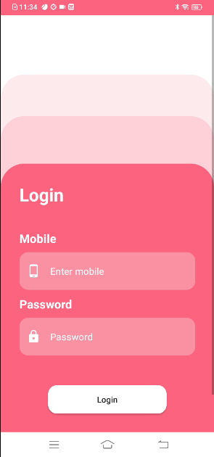
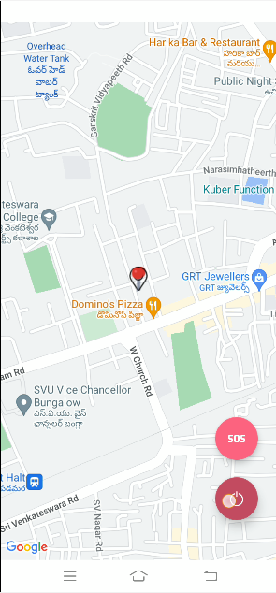

Outputs

Slide 18
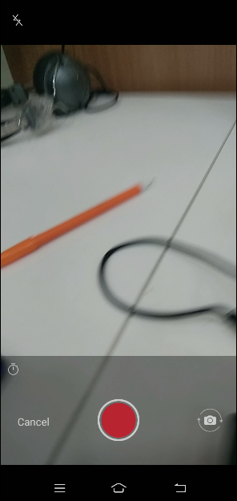
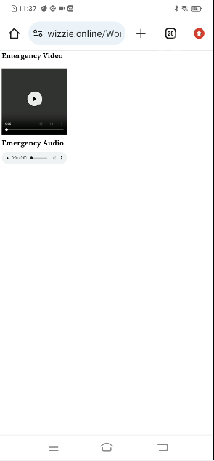
Outputs

Slide 19

Sustainable Development Goals

Slide 20




